Slide 1

Lecture 7
Software Design and Architecture
Rana Taimur Khan
Lecturer GCUF

Slide 2

Object Lifetime and Visibility Inheritance
What is inheritance
B inherits from A
A is the super or Base Class and B is the Sub or derived class.
A does not know about B

Slide 3
Object Lifetime and Visibility Inheritance
When an object of type B is created, a corresponding object of type A is also created.
Conceptually speaking, the object of type B holds the corresponding object of type A as a private component.

Slide 4
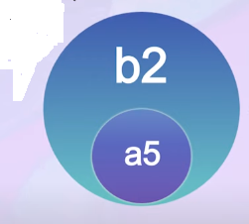
Object Lifetime and Visibility Inheritance
Example:
For example, when an object, say b2, of type B is created, another object, say a5, of type A is also created.

Slide 5
Object Lifetime and Visibility Inheritance
a5 is only accessible from b2.
Exclusive holding
The life of a5 is dependent upon b2.
a5 is created with b2 and it dies with b2.
Cardinality of this relationship is 1:1.

Slide 6
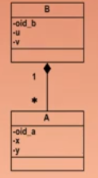
Object Lifetime and Visibility Composition
Composition:
Whole part relationship
B has many instances of A.
B is the container or whole, A is the part.
A does not know about B.

Slide 7
Object Lifetime and Visibility Composition
As we know that composition is:
A form of aggregation association with strong ownership and coincident lifetime of parts by the whole.
A part may belong to only one composite.
Parts with non-fixed multiplicity maybe created after the composite itself.
Once created, they live and die with it (that is they share lifetimes.)
Such parts can also be explicitly removed before the death of the composite.

Slide 8
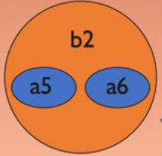
Object Lifetime and Visibility Composition
Example(Composition-Object creation and lifetime):
When object of type B is created
Corresponding instances of type A are
also Created.
Conceptually speaking, the object of
type B holds the corresponding objects
of type A as private components.

Slide 9
Object Lifetime and Visibility Composition
a5 and a6 are only are only accessible from b2 (exclusive holding).
The life of a5 and a6 is dependent upon b2.
a5 and a6 are created with b2 and destroyed with b2.
The cardinality of this relationship could be 1:1 or 1:m.

Slide 10
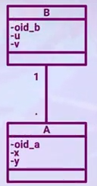
Object Lifetime and Visibility Association
Association:
One instance of B is associated with many
Instances of A.

Slide 11
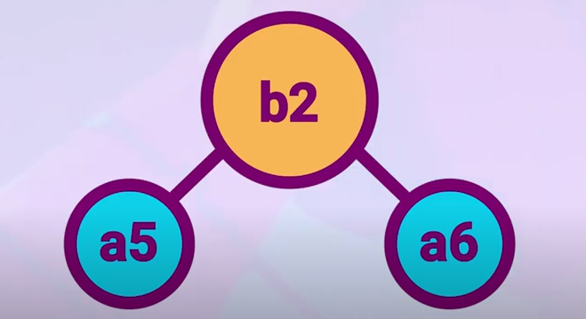
Object Lifetime and Visibility Association

Slide 12
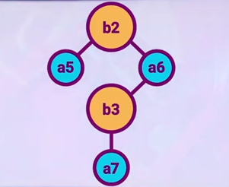
Object Lifetime and Visibility Association
When the relationship is not exclusive, the same instance of A may also be linked and accessed directly by other objects.

Slide 13
Object Lifetime and Visibility Association
Cardinality of this relationship could be
1:1
1:m
Or
M:m

